Slide 1
Technology Analyst Program End of Internship Presentation Karthik Suresh

Slide 2
Introduction
Background:
Rensselaer Polytechnic Institute (RPI), Troy, NY
Undergraduate: Computer Science & Economics
Previous Internship
2 startups in Medical Technologies
Internship Overview
Manager: Rama Yannam; Mentor: Priyank Shah
2 Sigma and Neurons Team
Program Manager
Danielle Kelly
2

Slide 3
Introduction
Projects worked on:
JSON Visualizer
Built an interactive 3D graph using D3js library to represent information flow in an intuitive manner
Manual Intent Classifier
Worked on creating a UI to manually classify and store intents when given an utterance
Analyzed Rasa framework
Currently working to see if the Rasa framework will fit with our current conversational model
Using Rasa we can generate stories instead of manually specifying them
What I enjoyed most in this internship:
Learning a vast array of technologies, and doing work that provided meaningful contributions to the team.
3

Slide 4
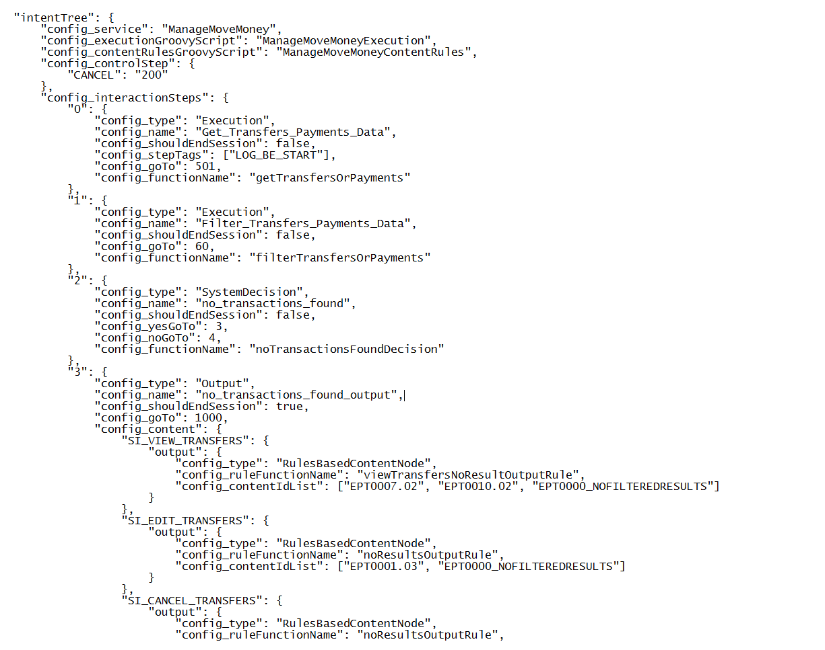
JSON Visualizer
file:///C:/Users/ZKU7VED/eclipse-workspace/jsonVisal/WebContent/moveMoney.html
3

Slide 5
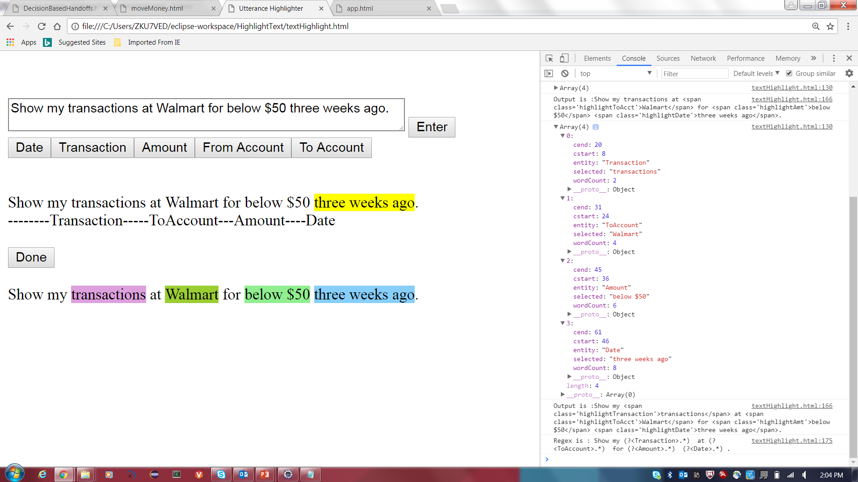
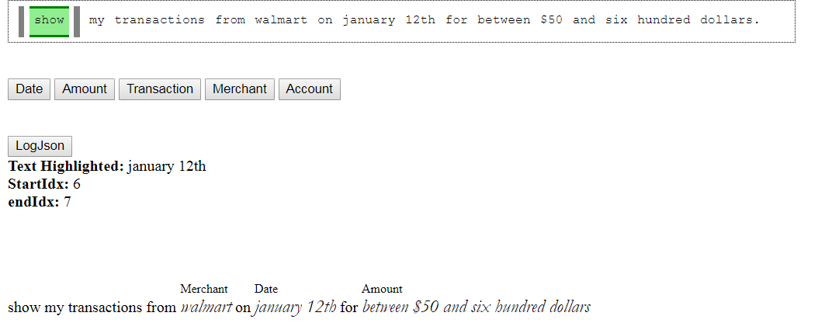
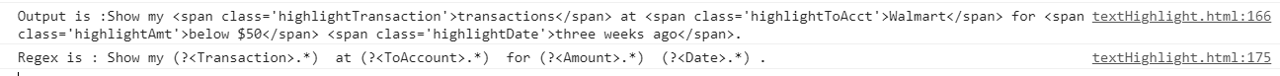
Manual Intent Classifier
3

Slide 6
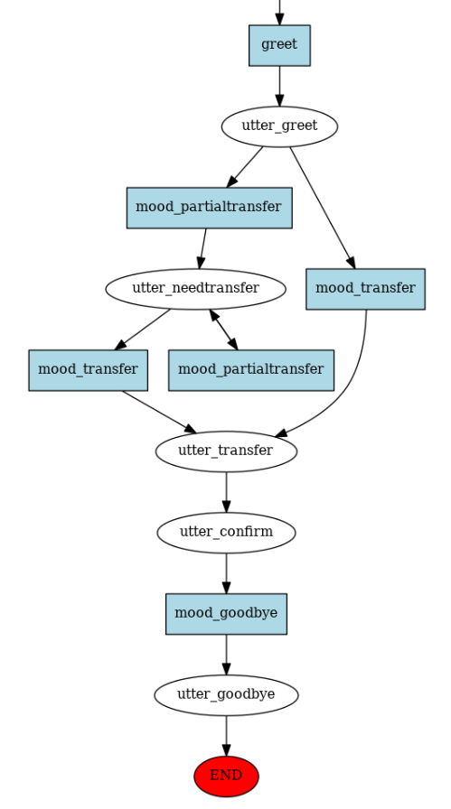
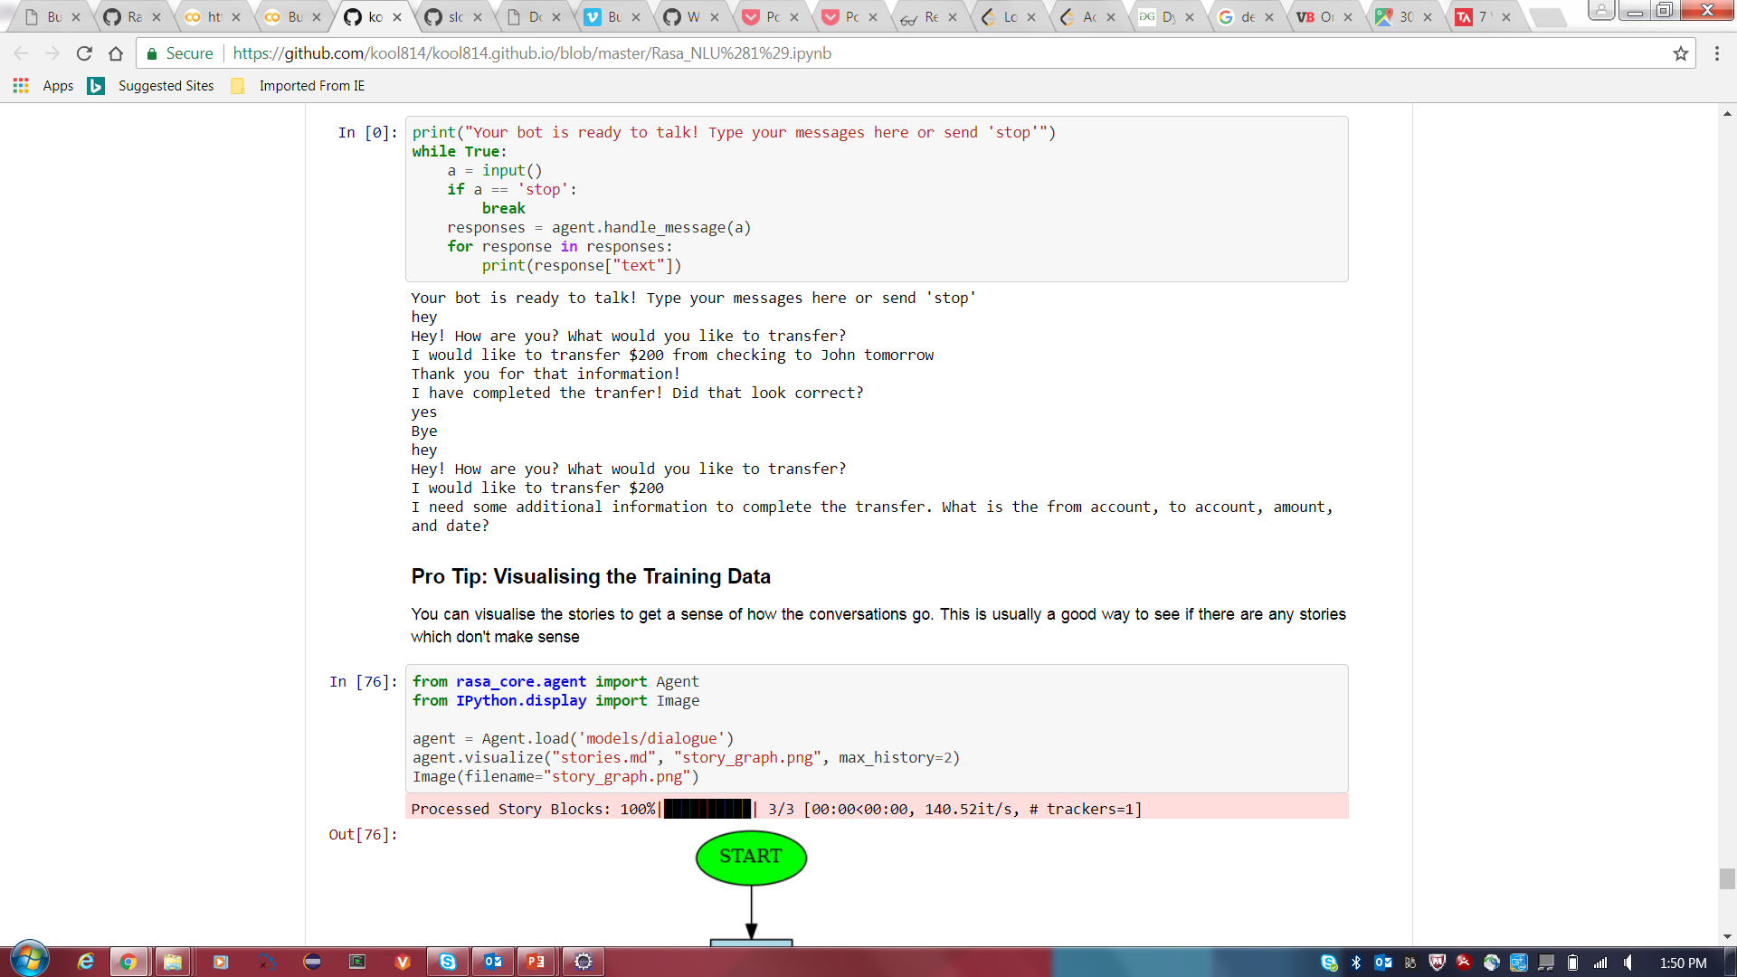
Rasa Framework
3

Slide 7
Problem Solving Strategy
Main challenge faced:
ARM requests
Learning new languages (i.e. JavaScript) while trying to complete task simultaneously
Understanding the conversational flow and other parts of codebase
Solution:
Learned to always start from beginning of a process and work through it
Asked team for help when in need of help
Key Takeaway:
Always take a step back, and go through the entire process to find the error quicker.
4

Slide 8
Unique Experience Gained
Personal Takeaways:
Used many new technologies
Fast paced development
Working in Corporate environment vs. Startup
Highlight of Internship:
Being exposed to many different technologies and learning and adapting quickly to complete assignments
5

Slide 9
Future Plans
Short term career plans:
Increase programming knowledge and become a great developer
Long term career plans:
I would like to eventually move into Machine Learning
How this Internship influenced my career path:
Helped me decide on pursuing developer path in a backend role
6

Slide 10
QUESTIONS

